Slide 1
It doesn’t matter what you call it. It matters that you do it.
Soil health practices
Conservation farming
Conservation cropping system
Nutrient loss reduction

Slide 2
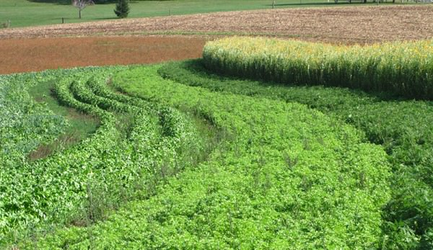
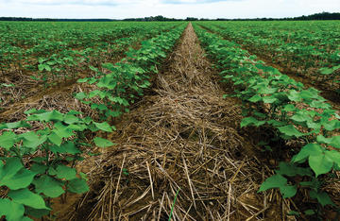
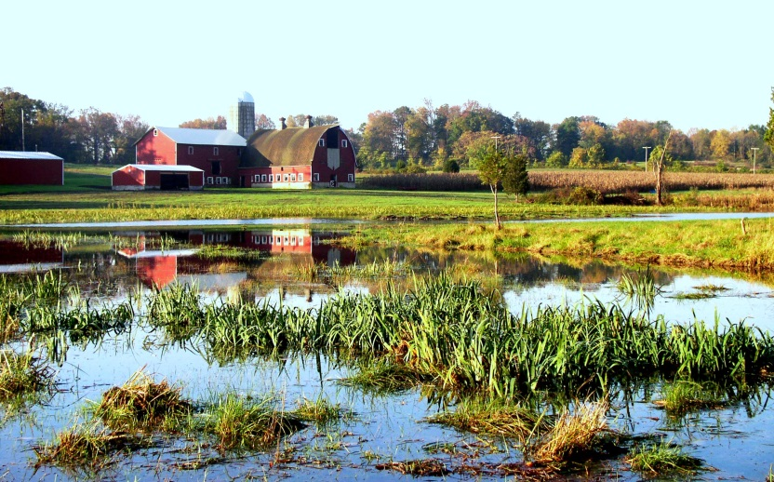
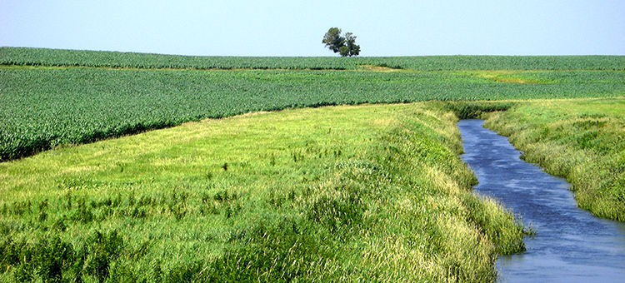
What is conservation farming?
A set of practices to improve soil health and profitability
Source: Sustainable Agriculture Research and Education
Source: Hobby Farms
Source: Waseca County, MN
Source: NRCS - USDA

Slide 3

A system approach
Conservation farming practices are best at retaining nutrients when paired together.
Choose the right practices for you, for each acre, for your land.

Slide 4

Where do I start?
Review the CONSERVATION FARMING: What’s your strategy? guide to figure out what set of smart practices make sense for your field.
Get the guide at [website].

